Slide 1



Project 2: Supervised Learning
James Sloan – IE 4910 – 3/25/2020

Slide 2
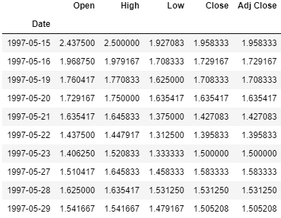
Amazon Stock Price 1997 - 2019

Slide 3

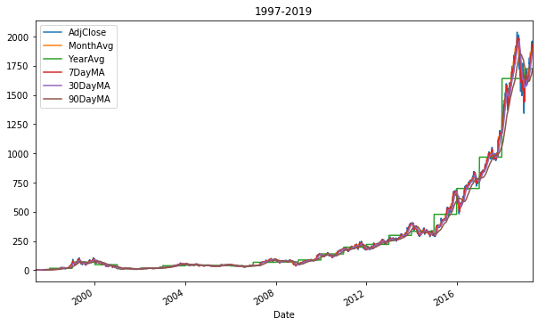
Time Series - Amazon Stock Prices
Added/Calculated Fields:
Monthly & Yearly Averages
7, 30, & 90 Day Moving Averages
Excluded fields:
Open, High, Low, & Close Price
They were very very close to Adj. Close.

Slide 4
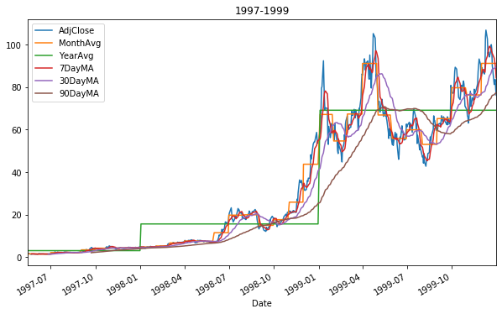
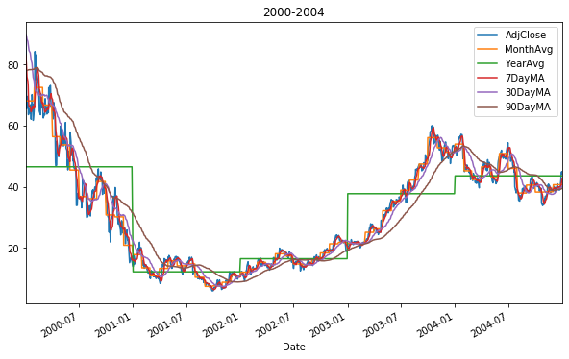
Breakdown: 1997 – 2004

Slide 5
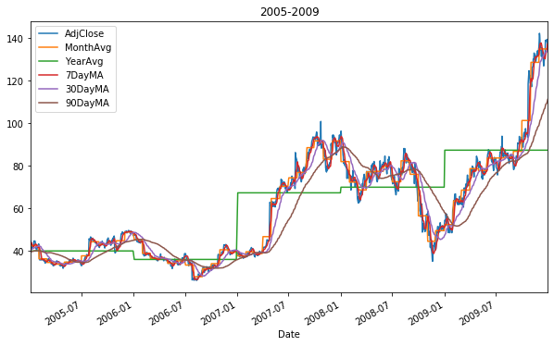
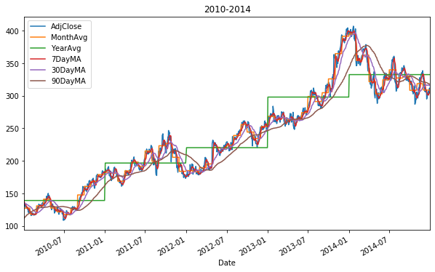
Breakdown: 2005 – 2014

Slide 6
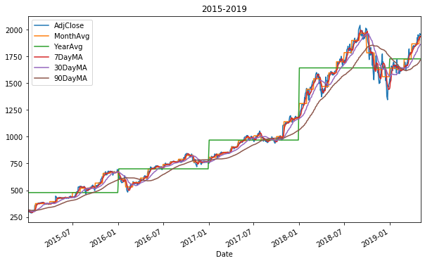
Breakdown: 2015 – 2019

Slide 7
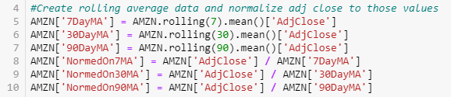
Calculated fields
Before calculating correlation matrices, several additional fields were calculated to see if they had any relationship to predicting closing price.
Moving Averages: (MA)
These were calculated based on the last 7, 30, and 90 days respectively.
Normalized Close based on MAs
This was calculated to see if the current closing price is equal to, greater than, or less than Mas to see if positive or negative momentum trends could be found.

Slide 8
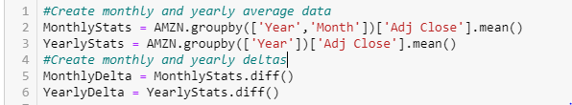
Calculated fields Cont….
Daily, Monthly, and Yearly Deltas:
This was calculated to have a somewhat consistent field across large differences in stock price over time.
Compared to other variables to see if the change in price can be predicted with our other variables.

Slide 9
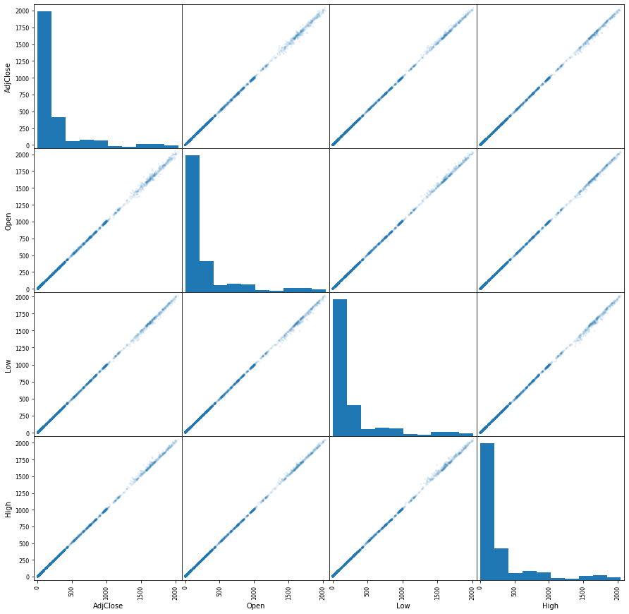

current Price variables vs Adj. Close
These variables are all captured during the current trading day.
They track very closely to the Adj. Closing price.
Unsurprisingly, they have very high correlation.

Slide 10
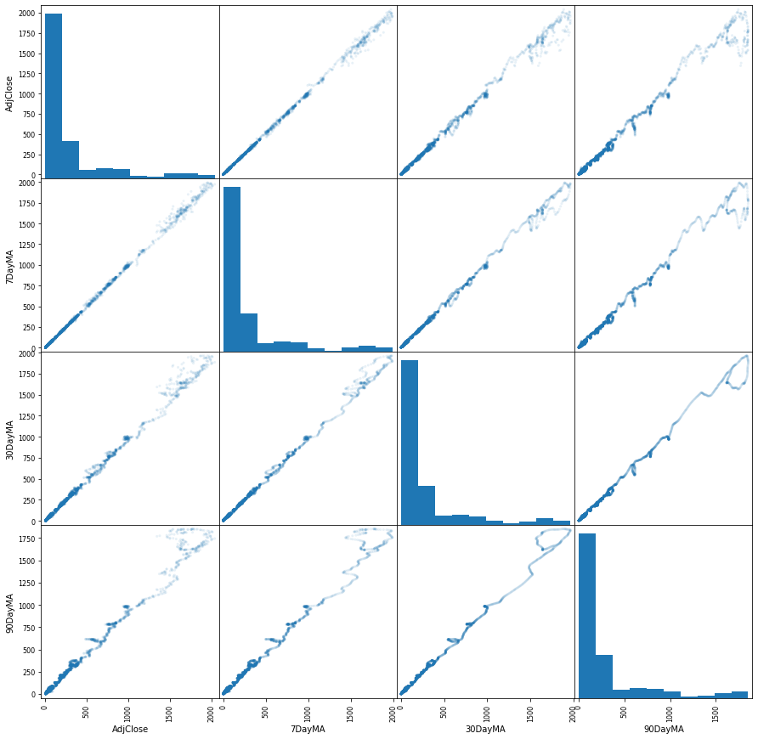
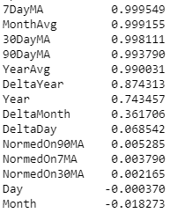
Historical Price variables vs. Adj. Close
These variables capture historical price information.
They are slightly less reliable than the current time variables.
However, their relations have much greater “real-world” usefulness for forward looking predictions.

Slide 11
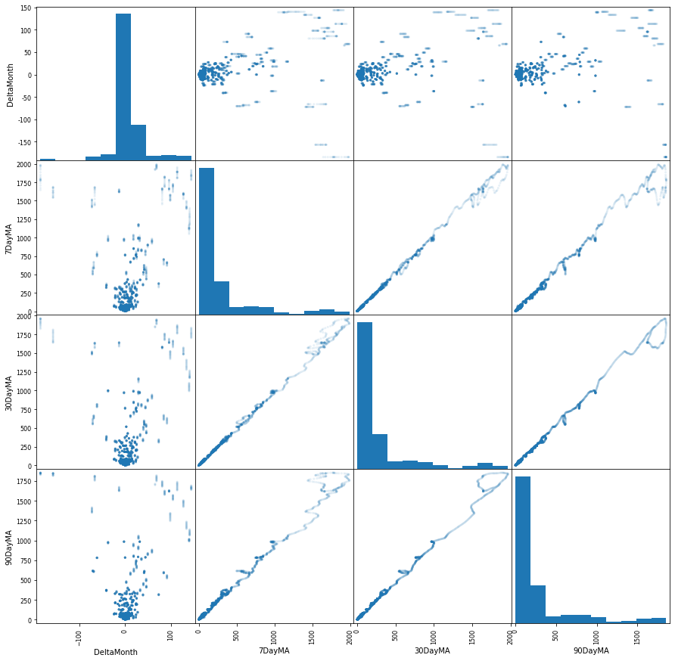
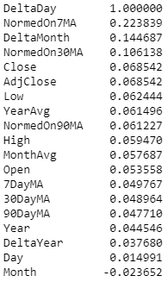
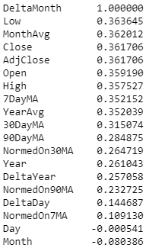
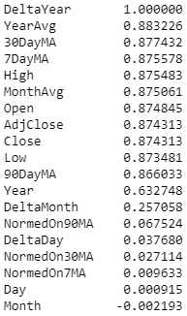
Monthly Price Delta Correlations
The change in price over a given time period can reflect whether an investment has a positive or negative outcome.
If it can be predicted by historical variables, this is highly powerful.

Slide 12
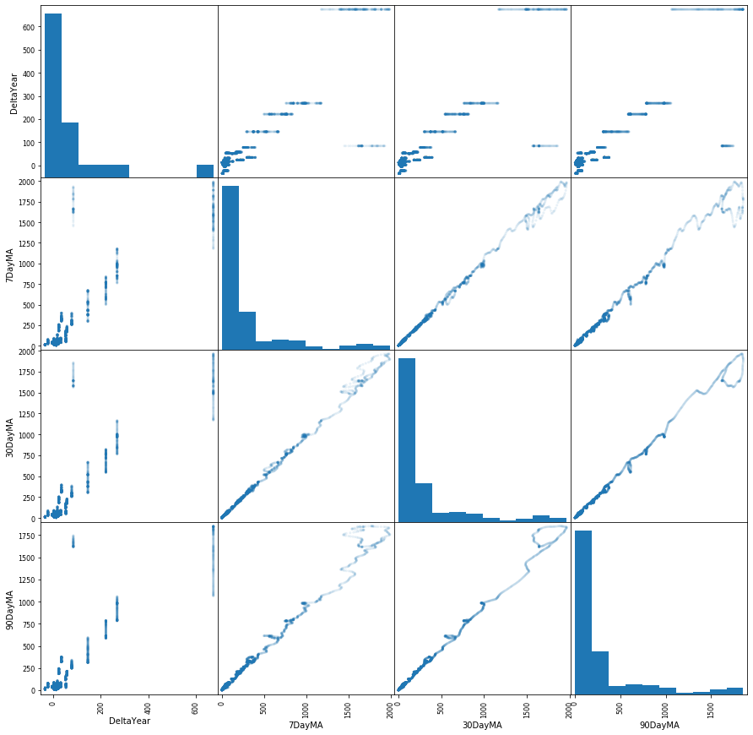
Yearly Price Delta Correlations
Yearly price changes have much higher correlations that the other deltas.
Due to the relatively small number of years, insights may be limited.

Slide 13
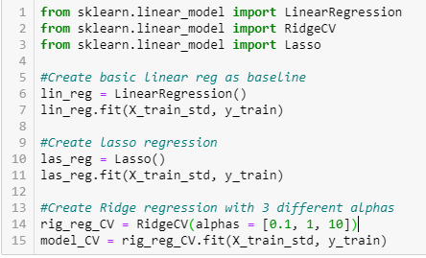
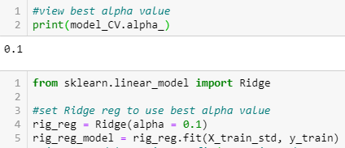
Creating regressions
Ridge Alpha Selection
By using the function RidgeCV, 3 alpha values were tested and the best one selected.
(Alpha = 0) is the same as Linear Regression.
We should expect Ridge to perform very similarly to Linear Regression.

Slide 14
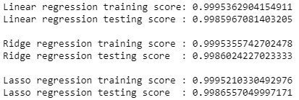
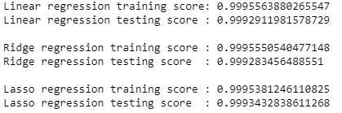
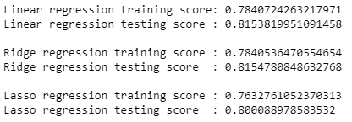
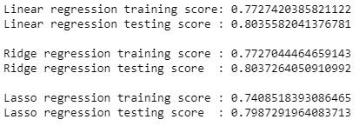
20% test set vs 50% Test set
Regression Score Predicting Adj. Close
Regression Score Predicting Adj. Close
Regression Score Predicting Yearly Delta
Regression Score Predicting Yearly Delta

Slide 15
Linear Regression vs. Ridge & Lasso
Regression Score Predicting Adj. Close
Best algorithm remained the same at 20% test set and 50% test set
Predicting the Adj. Close:
All methods had a score > 0.998
Ridge regression had the best score
Predicting the Yearly Delta:
Less predictable than the Adj. Close
Ridge regression had the best score
Regression Score Predicting Yearly Delta

Slide 16
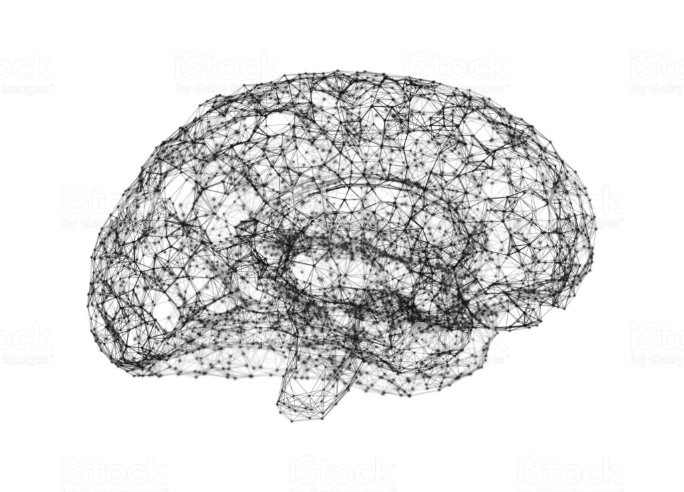
Mental Health in tech

Slide 17
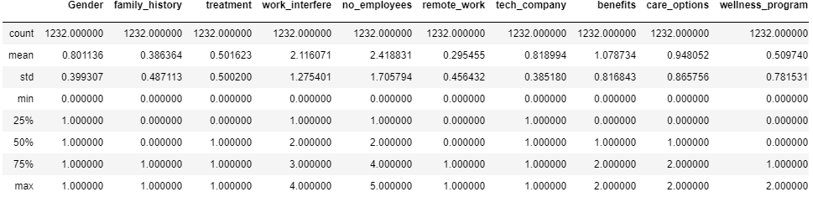
Summary of data
Gender
Female = 0, Male = 1
No Employees
1-5 = 0, 6-25 = 1, 26-100 = 2, 100-500 = 3, 500-1000 = 4
All Others
Numbers ordered 0 = most negative (No/Never/etc.), max = most positive (Yes/Often/Always/etc.)

Slide 18

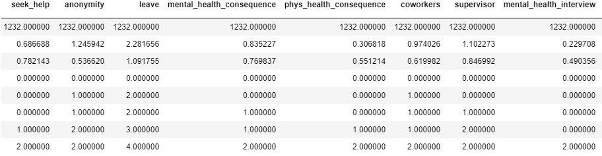
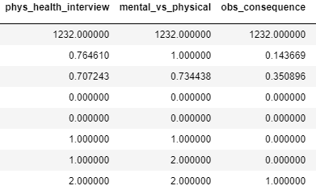
Summary of data Cont.
Gender
Female = 0, Male = 1
No Employees
1-5 = 0, 6-25 = 1, 26-100 = 2, 100-500 = 3, 500-1000 = 4
All Others
Numbers ordered 0 = most negative (No/Never/etc.), max = most positive (Yes/Often/Always/etc.)

Slide 19

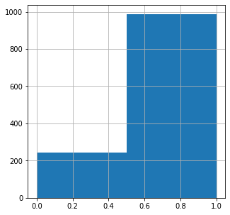
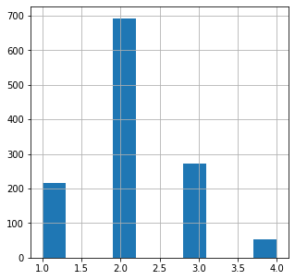
Age and gender demographics
Female Male <25 25-35 35-45 45+

Slide 20
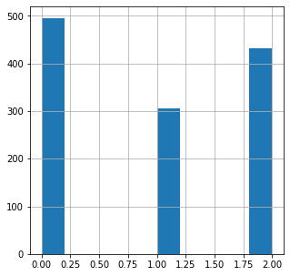
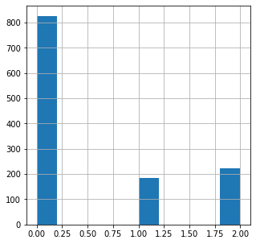
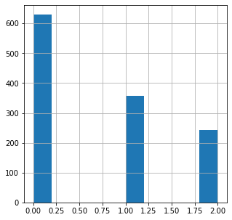
No Don’t know Yes No Not sure Yes No Don’t know Yes
History of seeking help? Care options? Wellness program?

Slide 21
Classification techniques
K-Nearest-Neighbors (KNN)
Random Forest
Passive Aggressive

Slide 22
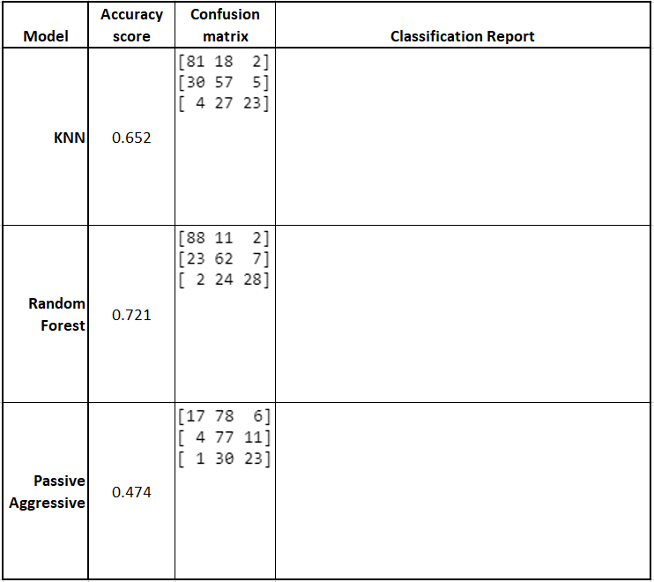
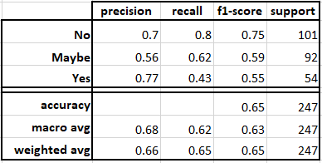
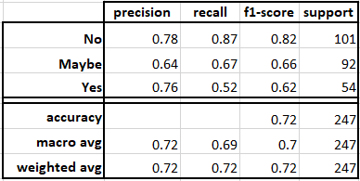
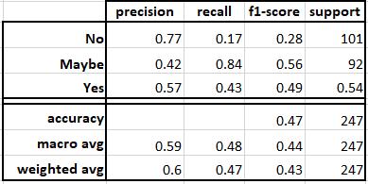
Summary
Random Forest is best
KNN is OK
Passive Aggressive is poor

Slide 23
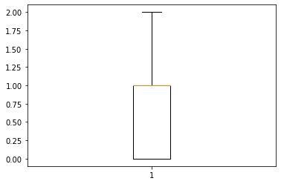
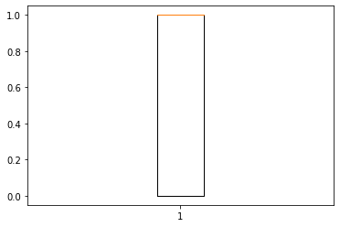
Error Boxplots
Since this was a classification task where the options are [0,1,2], the error for all algorithms fall in this range as well.
KNN favors 0 (“No”) due to there being vastly more “No”s than “Yes”s (more neighbors)
K-Nearest-Neighbors Random Forest Passive Aggressive

Slide 24
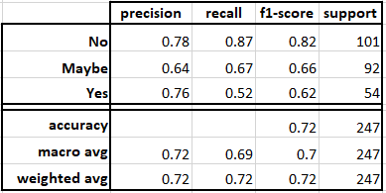
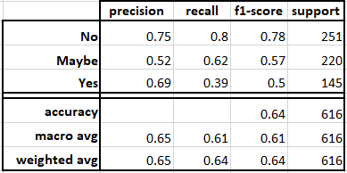


20% test set vs 50% Test set Random Forest

